Slide 1
Quipu
By Connor Wall

Slide 2
Comic Revisions
Includes both omniscient and ocean beginning
Condensed dialogue
More showing of priests and surroundings
Physical interpretations of abstract passages
HR
Notes:
https://pixabay.com/photos/modern-person-young-copyspace-2446997/
https://pixabay.com/photos/girl-glasses-studio-tenderness-4352423/
https://pixabay.com/photos/male-black-and-white-portrait-face-4494498/
https://pixabay.com/photos/business-woman-business-man-business-2071342/

Slide 3
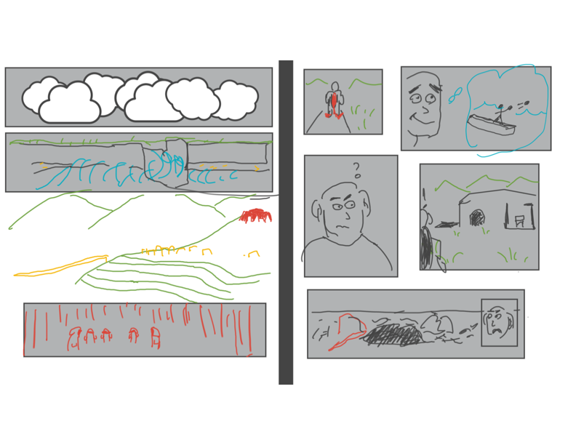
Comic
HR
Notes:
https://pixabay.com/photos/modern-person-young-copyspace-2446997/
https://pixabay.com/photos/girl-glasses-studio-tenderness-4352423/
https://pixabay.com/photos/male-black-and-white-portrait-face-4494498/
https://pixabay.com/photos/business-woman-business-man-business-2071342/

Slide 4
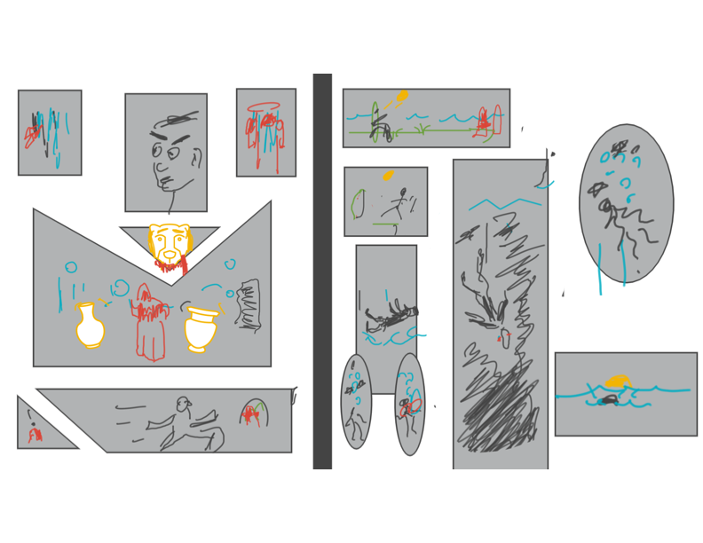
Comic
HR
Notes:
https://pixabay.com/photos/modern-person-young-copyspace-2446997/
https://pixabay.com/photos/girl-glasses-studio-tenderness-4352423/
https://pixabay.com/photos/male-black-and-white-portrait-face-4494498/
https://pixabay.com/photos/business-woman-business-man-business-2071342/

Slide 5
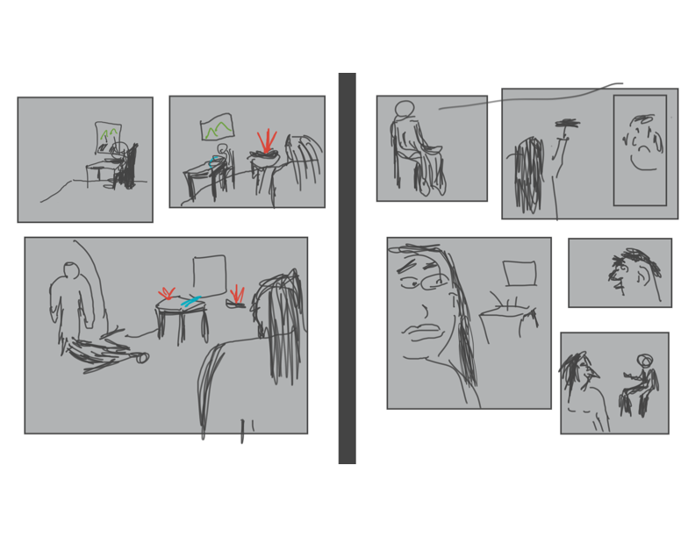
Comic
HR
Notes:
https://pixabay.com/photos/modern-person-young-copyspace-2446997/
https://pixabay.com/photos/girl-glasses-studio-tenderness-4352423/
https://pixabay.com/photos/male-black-and-white-portrait-face-4494498/
https://pixabay.com/photos/business-woman-business-man-business-2071342/

Slide 6
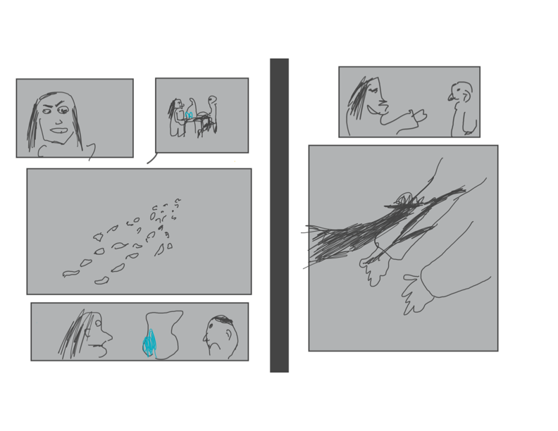
Comic
HR
Notes:
https://pixabay.com/photos/modern-person-young-copyspace-2446997/
https://pixabay.com/photos/girl-glasses-studio-tenderness-4352423/
https://pixabay.com/photos/male-black-and-white-portrait-face-4494498/
https://pixabay.com/photos/business-woman-business-man-business-2071342/

Slide 7
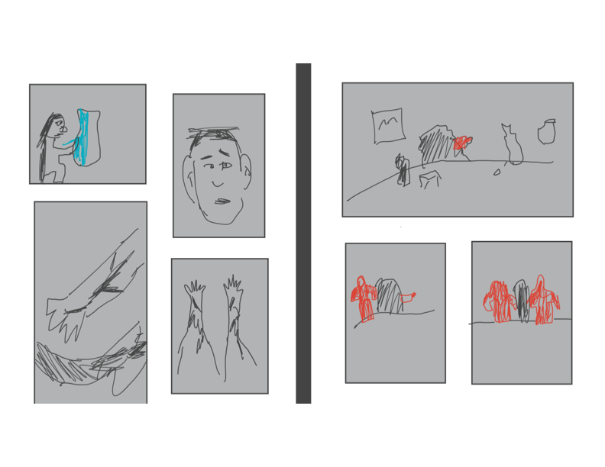
Comic
HR
Notes:
https://pixabay.com/photos/modern-person-young-copyspace-2446997/
https://pixabay.com/photos/girl-glasses-studio-tenderness-4352423/
https://pixabay.com/photos/male-black-and-white-portrait-face-4494498/
https://pixabay.com/photos/business-woman-business-man-business-2071342/

Slide 8
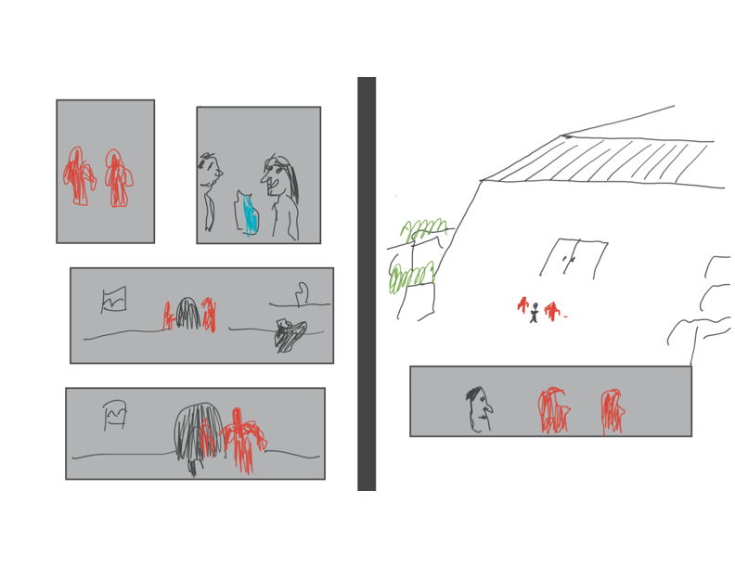
Comic
HR
Notes:
https://pixabay.com/photos/modern-person-young-copyspace-2446997/
https://pixabay.com/photos/girl-glasses-studio-tenderness-4352423/
https://pixabay.com/photos/male-black-and-white-portrait-face-4494498/
https://pixabay.com/photos/business-woman-business-man-business-2071342/

Slide 9
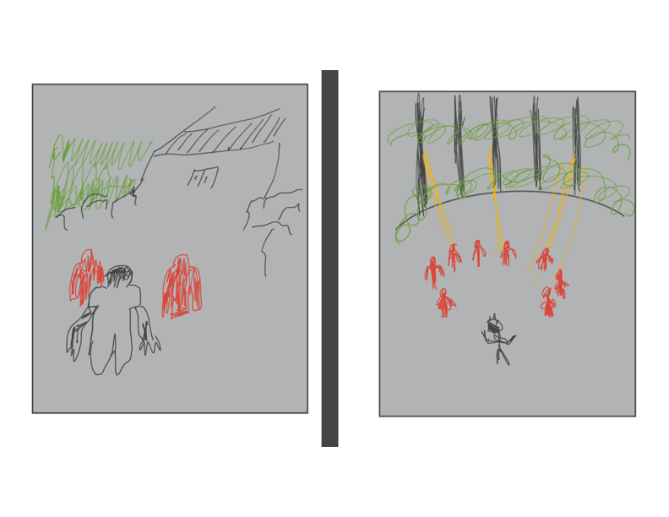
Comic
HR
Notes:
https://pixabay.com/photos/modern-person-young-copyspace-2446997/
https://pixabay.com/photos/girl-glasses-studio-tenderness-4352423/
https://pixabay.com/photos/male-black-and-white-portrait-face-4494498/
https://pixabay.com/photos/business-woman-business-man-business-2071342/

Slide 10
Screenplay Revisions
Consistent tone and formal for each character.
More reaction to dead family
More traditional linear chain of events
Artist – Diver relationship
Backstory and worldbuilding — showing with The artist dialogue
Fewer portal events
HR
Notes:
https://pixabay.com/photos/modern-person-young-copyspace-2446997/
https://pixabay.com/photos/girl-glasses-studio-tenderness-4352423/
https://pixabay.com/photos/male-black-and-white-portrait-face-4494498/
https://pixabay.com/photos/business-woman-business-man-business-2071342/

Slide 11
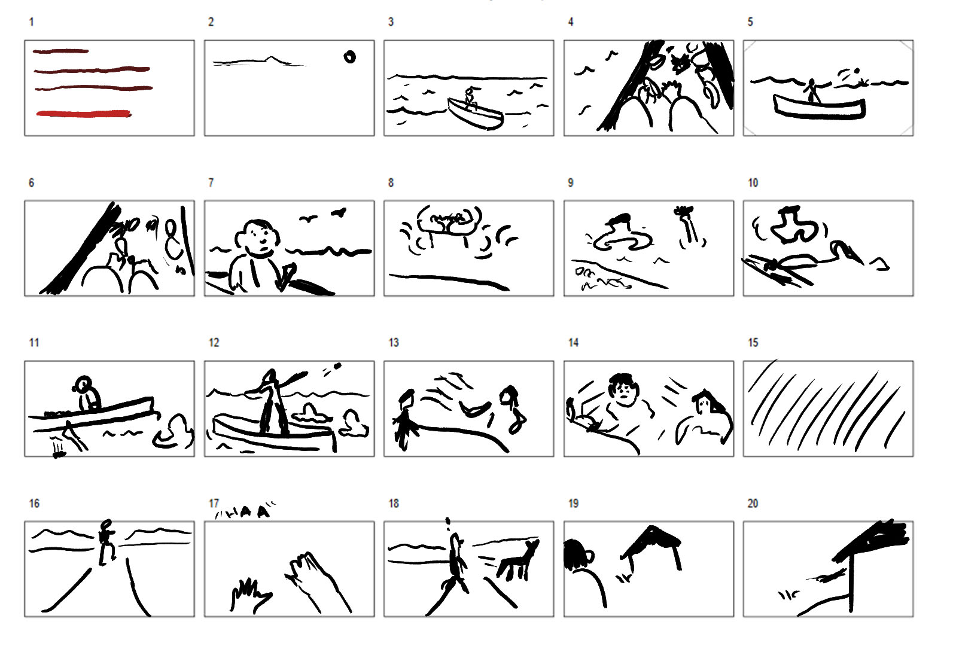
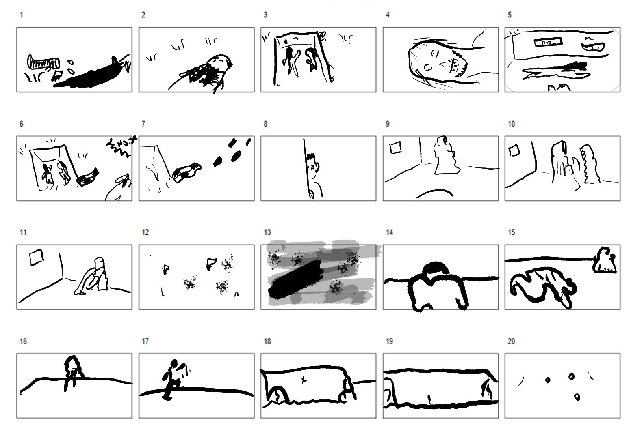
Storyboards
HR
Notes:
https://pixabay.com/photos/modern-person-young-copyspace-2446997/
https://pixabay.com/photos/girl-glasses-studio-tenderness-4352423/
https://pixabay.com/photos/male-black-and-white-portrait-face-4494498/
https://pixabay.com/photos/business-woman-business-man-business-2071342/

Slide 12
Takeways
Character driven vs environmental driven
Worldbuilding using cultural references
Illustrating shots vs beats
Using real life experience + reference material for natural characters
HR
Notes:
https://pixabay.com/photos/modern-person-young-copyspace-2446997/
https://pixabay.com/photos/girl-glasses-studio-tenderness-4352423/
https://pixabay.com/photos/male-black-and-white-portrait-face-4494498/
https://pixabay.com/photos/business-woman-business-man-business-2071342/

Slide 13
Future
Priest backstory
Priests + societal context
How is reality shaped by technology?
How can technology exist within a spiritual framework and become central to religion?
Matte painting + 3D Render -> understand spiritual + mental limits of characters
HR
Notes:
https://pixabay.com/photos/modern-person-young-copyspace-2446997/
https://pixabay.com/photos/girl-glasses-studio-tenderness-4352423/
https://pixabay.com/photos/male-black-and-white-portrait-face-4494498/
https://pixabay.com/photos/business-woman-business-man-business-2071342/

